Slide 1
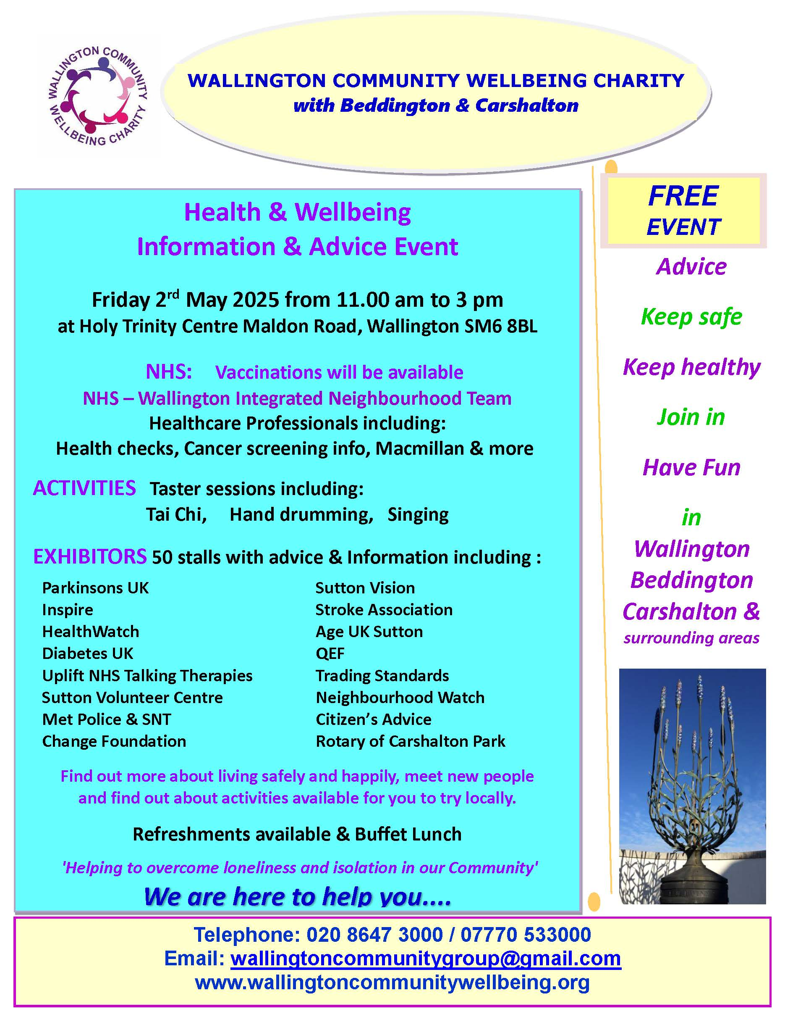
Slide 1
Next Health & Wellbeing Information
and Advice Day
Friday 2nd May
Notes:
Our next event will be similar to the usual ones and will be on 2nd May. Please put the date in your diaries.

Slide 2
Slide 2
Notes:
We have updated the flyer for ‘Healthy You’ that takes place in St Paul’s Church Roundshaw on the Last Thursday of the month to coincide with the usual Drop in sessions at The Phoenix Centre where residents can meet their MP, Local Councillors, Metropolitan Homes, the estate landlord and other useful contacts. Our Charity supports the NHS by hosting the Monthly ‘Healthy You’ sessions paying for printing flyers, hall hire etc.
The Sutton INT’s have been asked to focus on Cardiovascular disease as a main project. Wallington INT has been doing this for the past year or more by providing Health Coach sessions, regular BP and BMI monitoring and other help.
We are now moving on with more pressing local issues, those of Mental Health. The new flyers re now available and will preplace the previous ones mentioning Healthy weight as we move to a more holistic view with the Lifestyle Coaches aligning their sessions more broadly.
Just to note - Whilst these sessions take place in Roundshaw
I need to stress that they are open to all residents locally and especially those whose GP’s are in the Wallington INT part of the Sutton Primary Care Network.

Slide 3
Slide 3
Notes:
On the reverse of the Healthy You flyer is a list of regular exhibitors at the Phoenix Centre Drop in Sessions, also on the Last Thursday of each month.
We are keen to add to these and most recently I have been in contact with Citizens Advice Bureau Sutton who will be attending from now on as often those that access their services are at the end of their tether due to debt, housing issues, problems accessing benefits etc.
This leads us on to another vital project – that of Mental Health.
In the months leading up to Christmas there were 4 suicides in Roundshaw which is a tragic statistic that needed addressing quickly so Dr Raza Toosy and I looked into the patient Health data for Mental Health in the area..
The results were quite shocking with a huge increase in the numbers of Mental Health referrals. Talking to residents also showed their mounting concerns regarding the mental health of young adults.

Slide 4
Slide 4
Notes:
So, our Charity is delighted to have been able to work with Mthr Berni, the Wallington INT and Scott from The Proper Blokes Club and between us we have created a Man Space – a Safe place for men to get together for a chat on ‘Men’s Monday’ from 6 to 9 pm. When the church is open to any men that want to pop in for a chat and free refreshments. If you have mobility issues or do not want to walk then you are still welcome to attend

Slide 5
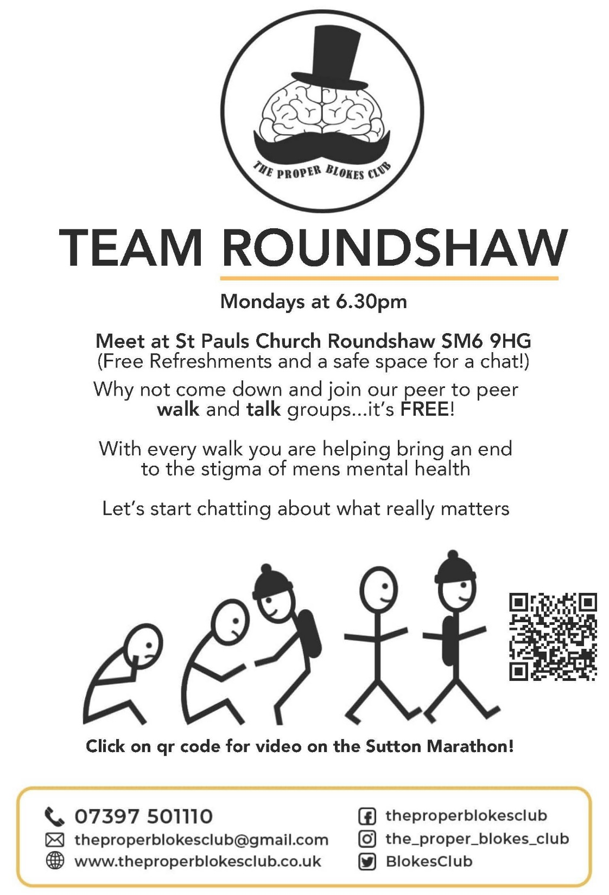
Slide
Notes:
The Charity also commissioned Scott and The Proper Blokes Club to provide the first 13 weeks of this Men’s Walk & Talk project that started on 20th January (Known as Blue Monday – said to be the most depressing day of the year)
We are hoping to encourage all men, Even if they don’t have any issues themselves to consider joining in the walk that is only 1 hour as you never know who you might be helping just by being there.
Numbers have been quite low so far mainly due to adverse weather but we expect the numbers to increase as Spring comes with the lighter evenings. Please help get the word out there!
If you don’t know about Scott already do read up on The Proper Blokes Club – on Facebook, and many other social media platforms. He is inspirational having conquered his own problems with addictions to champion Men’s Mental Health .
He is doing 32 Marathons this year, one in each London Borough to raise awareness and a couple of weeks ago did one in Sutton and there are YouTube videos of him travelling the borough. – Well worth watching!

Slide 6
Slide 6
Notes:
The other part of Mental Health we are going to be working with is Dementia – something that many people are concerned about so we have added that as a priority as well and are looking to open a Dementia cafe in the church in May.
This will be for people and their carers and we hope to provide a time for carers to be able to have a break and chat to others so they receive some peer support whilst the other group have an activity.
On Thursday 27th March we will have Part 2 of our conversation on Dementia in the Church from 10.30 to 1 pm with some suitable exhibitors that can guide people to where there is help and support.
The first session was in January and was very well received and this time we will have even more speakers and exhibitors.
If anyone has any questions about where the Wallington INT is heading or what we are doing I am happy to answer them.

